Slide 1
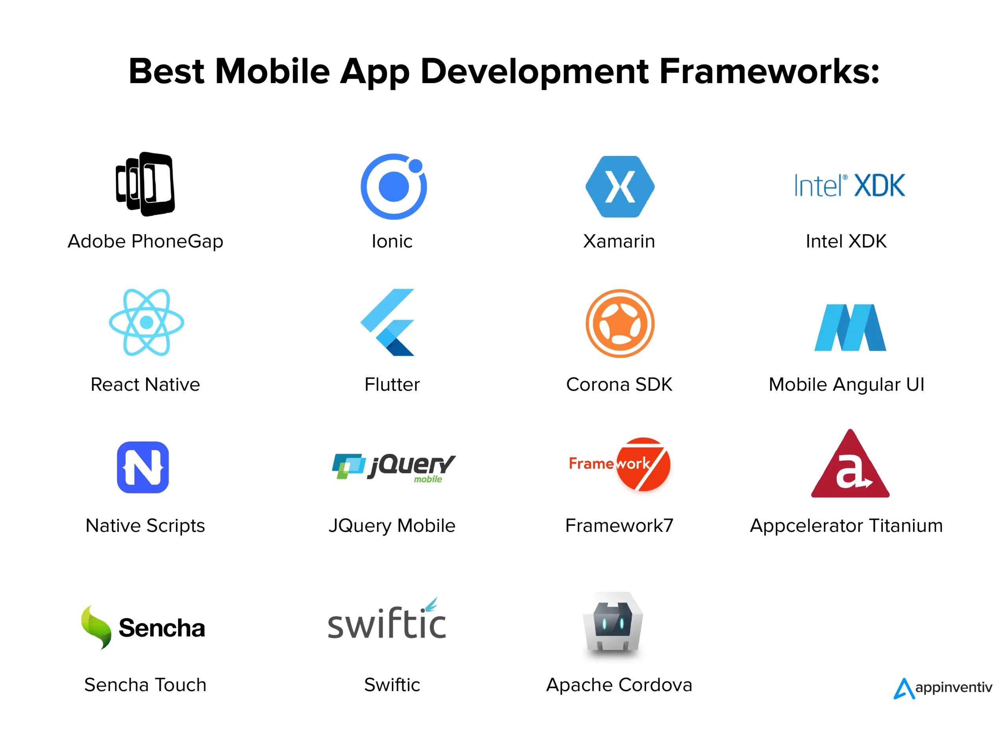
Mobile App Development : Types, Frameworks, Architectures, and Cost Estimation.
Developing a comprehensive understanding of mobile application development by exploring key aspects that influence the design, development, and deployment of mobile apps.
Group 1
NT
ARREY-TABOT PASCALINE FE22A151
TANUI NORBERT TANGIE FE22A306
OROCKTAKANG MANYI FE22A293
NGATTA GEORGE TABOT FE22A259
SIDNEY FOMECHE FE22A218

Slide 2
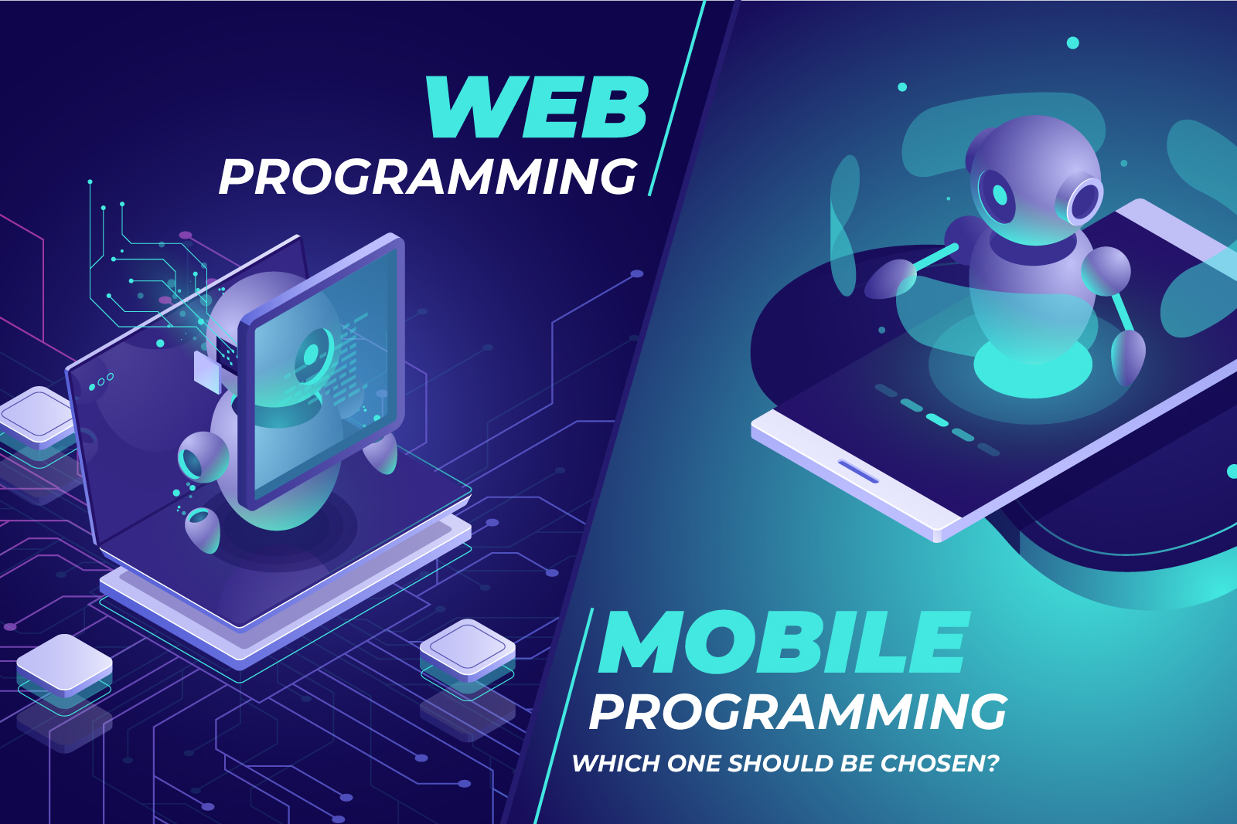
Types Of Mobile Apps And Their Differences
A mobile app is a software application designed to run on mobile devices such as smartphones and tablets. It provides specific functionalities such as communication, entertainment, productivity, or business services and can be developed on platforms like iOS, and Android.
Native Apps
Hybrid Apps
Progressive Web Apps
A combination of web and native app elements. Built using web technologies (HTML, CSS, JavaScript) and wrapped in a native container. Offers cross-platform compatibility but may sacrifice performance.
Built specifically for a particular mobile OS (iOS or Android). Offers the best performance and access to device features.
Responsive websites that look and function like mobile apps. Accessed through a web browser and do not require installation.
Optimal performance
No installation required
Full device access
Cross-platform
Cross-platform
Platform-specific
Web technologies
Limited device access
Potential performance issues

Slide 3
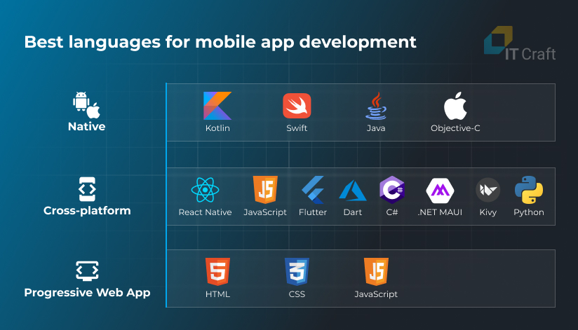
Mobile App Programming
Languages
Native Languages
Swift
Primary modern syntax. language for iOS app development. Known for its safety, speed, and m
Kotlin
Official language for Android app development. Interoperable with Java and offers modern features.
Java
A widely-used language for Android development with a large community and cross-platform capabilities, but has more verbose syntax and can be slower than Kotlin.

Slide 4
Mobile App Programming
Languages
Cross-Platform Languages
C#(Xamarin)
A cross-platform framework using C# and the .NET ecosystem. Enables development for iOS, Android, and Windows with a shared codebase. Offers strong integration with Microsoft tools but may have performance variability.
Dart(Flutter)
Used with the Flutter framework for cross-platform app development. Allows a single codebase for both iOS and Android, offering fast development with features like hot reload and good performance.
JavaScript
A cross-platform framework using JavaScript. Allows a single codebase for iOS and Android, providing near-native performance and fast development with a large, active community.

Slide 5



Overview of Mobile App Development Frameworks
React Native
Flutter
Developed by Google, uses Dart language to create high-performance, cross-platform apps with a rich UI.
Uses JavaScript and React to build native mobile apps. Offers code reusability and fast development.
Xamarin
Uses C# to build cross-platform apps. Allows sharing of code across iOS, Android, and Windows.

Slide 6
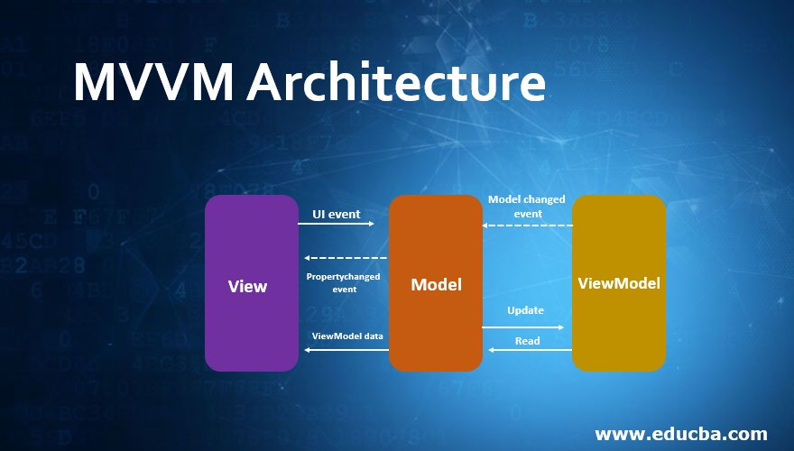
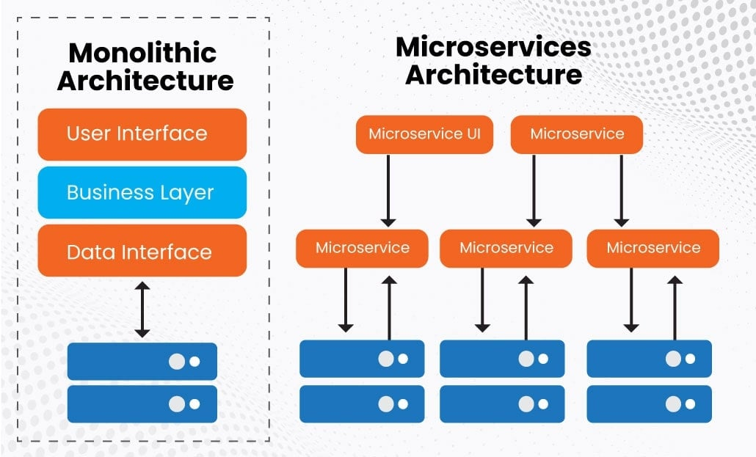
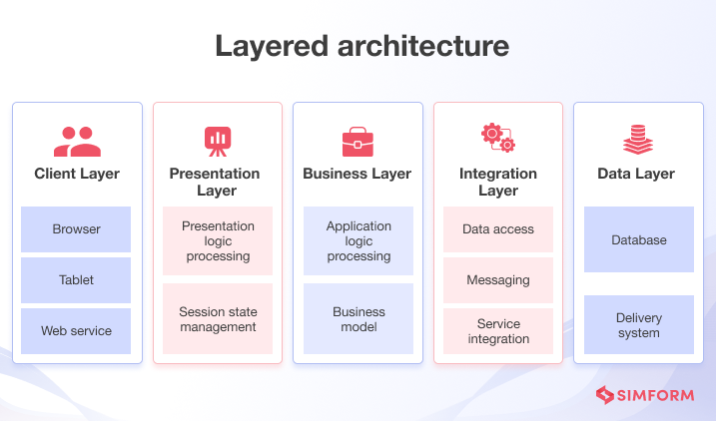
Mobile App Architectures and Design Patterns.
Mobile Application Architectures
1. Monolithic Architecture
2. Layered Architecture
3. Microservice Architecture
4. Model-View-Model (MVM) Architecture

Slide 7
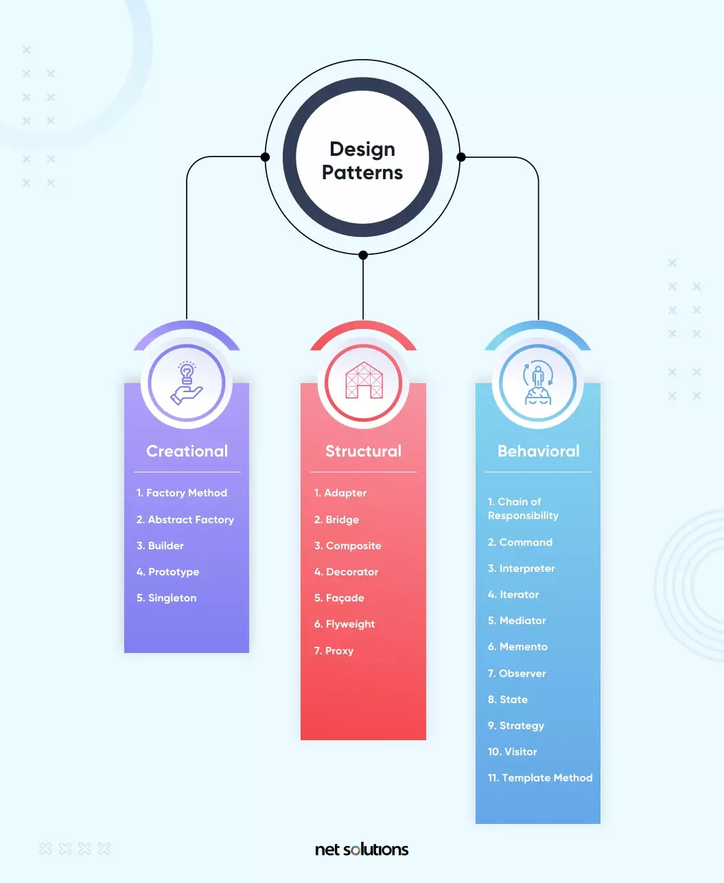
Design Patterns in Mobile App Development.
Singleton Pattern
Ensures only one instance of a class exists and provides a global access point.
2. Factory Pattern
Creates objects without specifying their exact class, making the code more flexible.
Observer Pattern
Defines a dependency between objects so that when one changes, all dependent objects are notified .
Repository Pattern
Abstracts data access logic, creating a clean separation between business logic and data sources.
Dependency Injection
Instead of creating dependencies inside a class, they are “injected” from outside, improving testability and flexibility.

Slide 8
User Requirements Engineering
Steps in
1. Requirement Elicitation (Gathering)
2. Requirement Analysis
Requirement
3. Requirement Specification
4. Requirement Validation.
Engineering
ESTIMATING MOBILE
APP DEVELOPMENT COST
Techniques include surveys, interviews, and user stories. Defining scope ensures project stays on track.

Slide 9
REQUIREMENT ENGINEERING
Below are the methods used to gather information.
User Survey
Questionnaires
Stakeholder interviews
Market Competition Analysis
Focus Groups And Workshops

Slide 10
Estimated Cost
Key Cost Factors
Cost Estimation Approach
App complexity
Platform choice (either Hybrid or Native)
UI/UX Design
Backend and API
Bottom up estimation (The project is broken up into small tasks) .The Sum provides the total cost
This methos is highly accurate and best suited for agile Teams
Other hidden cost include Appstore fees, marketing and User acquisition

Slide 11
THANK YOU.

